Slide 1













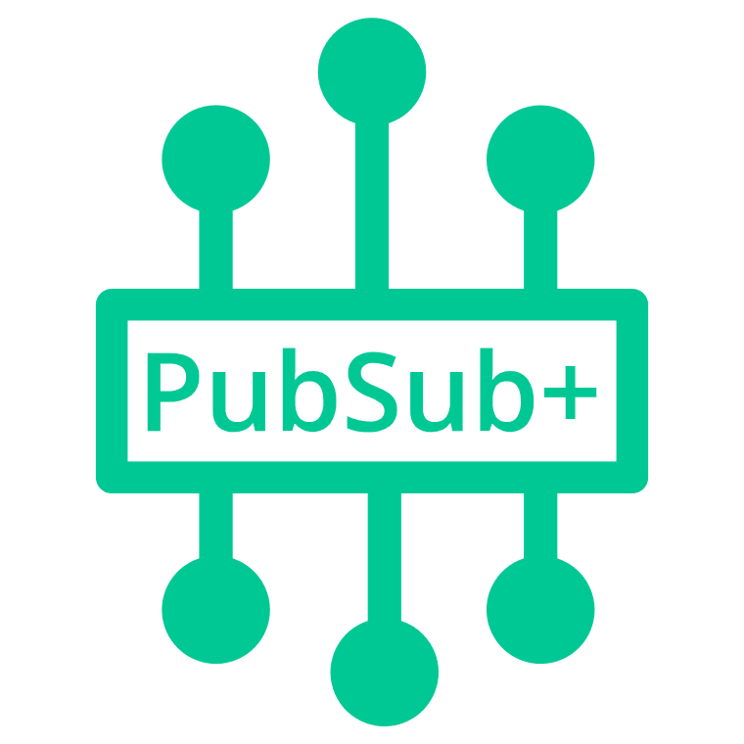


AWS Cloud
Client Access
Solace SMF, REST, WebSocket, MQTT, AMQP etc.
Open standard protocols and APIs
Availability Zone 1
Availability Zone 2
Availability Zone 3
VPC
Messaging client
Public subnet
Public subnet
Public subnet
10.0.128.0/26
10.0.129.0/26
10.0.130.0/26
HTTPS
NAT gateway
NAT gateway
NAT gateway
Internet gateway
Linux Bastion Auto Scaling group
PubSub+ Manager in Browser
Bastion host
SSH traffic
Bastion host
SSH traffic
Admin
Management client
Solace SEMP,
SSH (for CLI)
Private subnet
Private subnet
Private subnet
10.0.128.64/26
10.0.129.64/26
10.0.130.64/26
S3 Template Storage
Elastic Load Balancing (ELB)
Monitoring Node
Primary Broker Node
Backup Broker Node
Cloud Initialization logs
10.0.128.0/22

